Slide 1
CS4038
DATA MINING
LECTURE # 22
SPRING 2024
FAST – NUCES, CFD CAMPUS
AYESHA LIAQAT
ayesha.liaqat@nu.edu.pk

Slide 2
TODAY’S TOPICS
K-Means++
K-Medoid (or PAM)

Slide 3
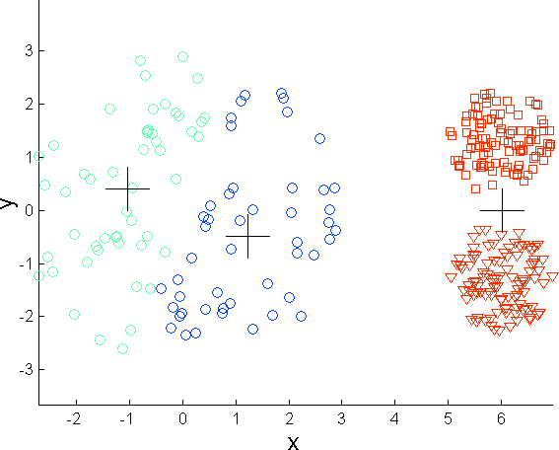
LIMITATIONS OF K-MEANS
In Lloyd’s algorithm for K-Means clustering, the initial centroids are picked randomly. Hence, the final formed clusters depend on how initial centroids were picked.
Also, the updated centroids are the means of all data points in a cluster. These centroids are not representative of original data points and can be affected by outliers.
K-means (3 Clusters)

Slide 4
K-MEANS VARIANTS
There are two approaches to avoid this problem of initialization sensitivity:
Repeat K-means: Repeating the algorithm and initialization of centroids several times and pick the clustering approach that has small intra-cluster distance and large inter- cluster distance.
K-Means++: K-Means++ is a smart centroid initialization technique.
The idea is to pick the initial k centroids as far as possible.
The rest of the algorithm is the same as that of K-Means.

Slide 5

K-MEANS++
Pick the first centroid point (C₁) randomly.
Compute distance of all points in the dataset from the selected centroid. The distance of x_{i} point from the farthest centroid can be computed by:
d_{i}: Distance of x_{i} point from the farthest centroid m: number of centroids already picked
Make the point x_{i} as the new centroid that is having maximum probability proportional to d_{i}.
Repeat the above two steps till you find k-centroids.

Slide 6
K-MEDOID ALGORITHM

Slide 7
WHAT IS THE PROBLEM OF THE K-MEANS METHOD?
The k-means algorithm is sensitive to outliers!
Since an object with an extremely large value may substantially distort the distribution of the data
K-Medoids: Instead of taking the mean value of the object in a cluster as a reference point, medoids can be used, which is the most centrally located object in a cluster
Also called as Partitioning Around Medoid (PAM)
A medoid can be defined as a point in a cluster whose total dissimilarity with all the other points in the cluster is minimum.
10
10
9 |  | 9
8 |  | 8
7 |  | 7
6 |  | 6
5 |  | 5
4 |  | 4
3 |  | 3
2 |  | 2
1 |  | 1
 |  | 0
0
0 1 2 3 4 5 6 7 8 9
10
0 1 2 3 4 5 6 7 8 9 10
7

Slide 8
PAM: A TYPICAL K-MEDOIDS ALGORITHM
Algorithm:
Initialize: select k random points out of the n data points as the medoids.
Associate each data point to the closest medoid by using any common distance metric methods (e.g., Manhattan, Euclidean distance).
While the cost decreases:
For each medoid m, for each data o point which is not a medoid:
Swap m and o, associate each data point to the closest medoid,
recompute the cost.
If the total cost is more than that in the previous step, undo the swap.

Slide 9
PAM: A TYPICAL K-MEDOIDS ALGORITHM
10
10
9
8
7
6
5
4
3
2
1
0
0 1 2 3 4 5 6 7 8 9 10
10
9
8
7
6
5
4
3
2
1
0
0 1 2 3 4 5 6 7 8 9 10
Total Cost = 20
9
8
Arbitrar y choose k object as initial medoids
Assign each remainin g object to nearest medoids
7
6
5
4
3
2
1
0
0 1 2 3 4 5 6
7
8
9 10
K=2
Randomly select a non- medoid object,O_{ramdom}
Total Cost = 26
Do loop
Until no change
10
10
9
9
8
Swapping O and O
8
Compute total cost of swapping
ramdom
If quality is improved.
7
6
7
6
5
5
4
4
3
3
2
2
1
1
9
0
0 1 2 3 4 5 6 7 8 9 10
0
0 1 2 3 4 5 6 7 8 9 10

Slide 10

PAM: A TYPICAL K-MEDOIDS ALGORITHM
The dissimilarity of the medoid (Ci) and non-medoid data object (Pi) is calculated by using E = |Pi - Ci|
The cost in K-Medoids algorithm is given as:

Slide 11
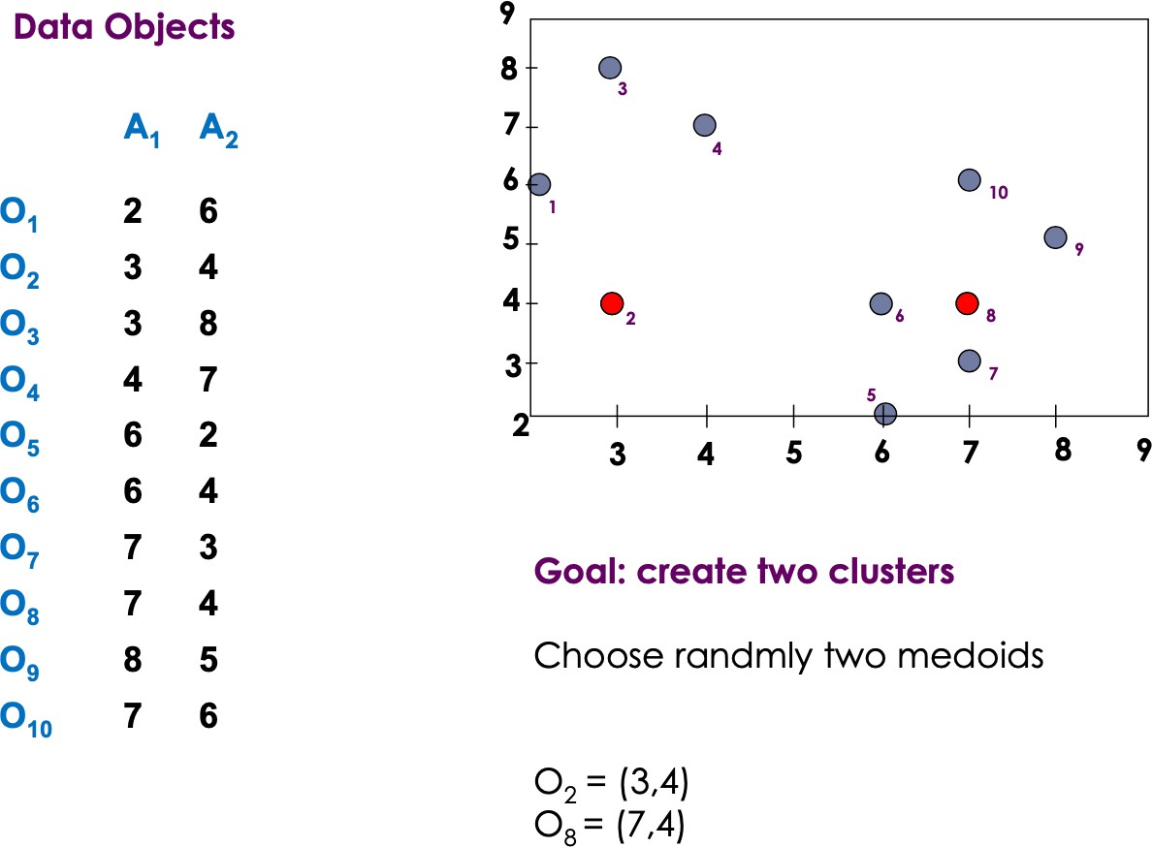
EXAMPLE

Slide 12
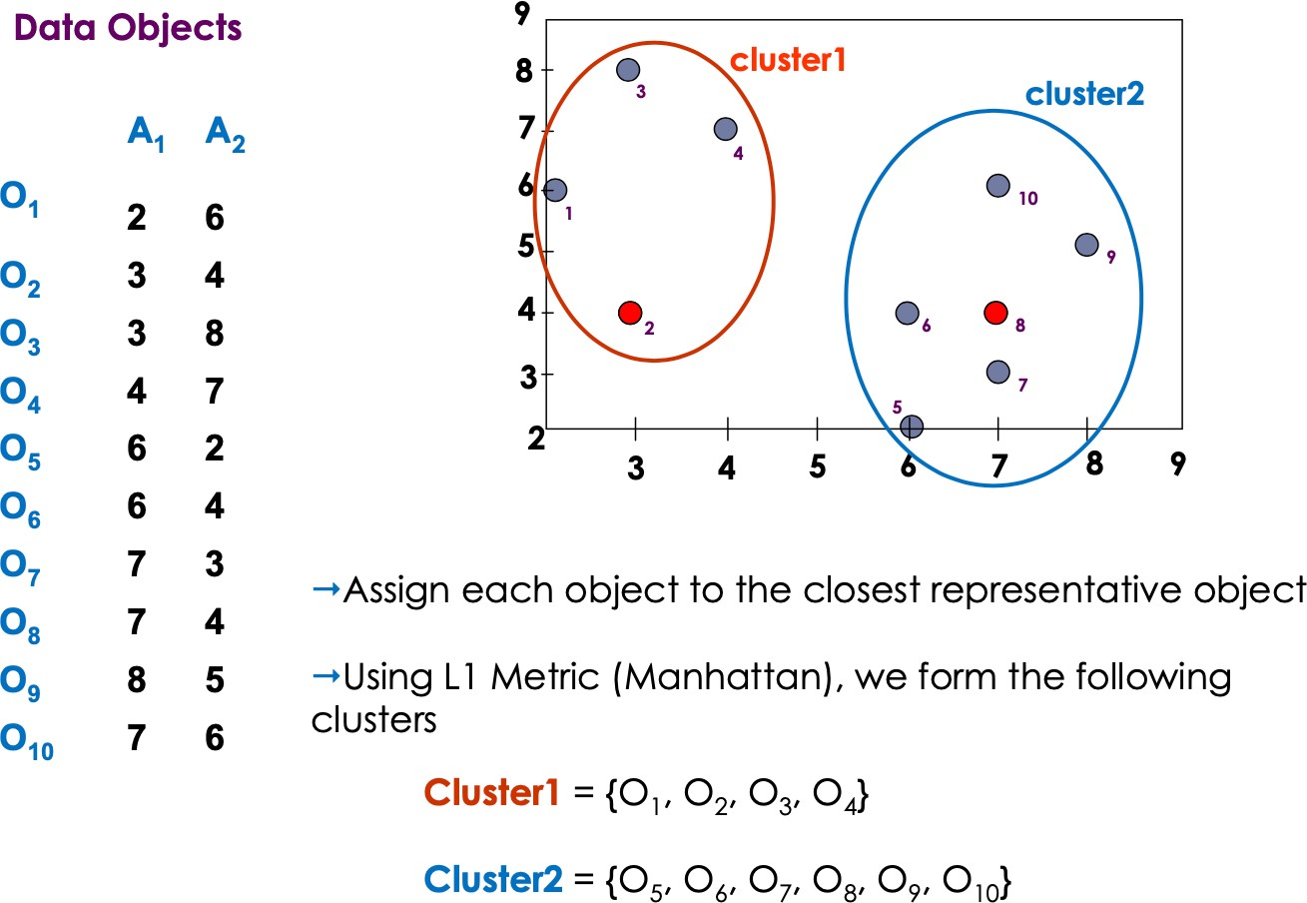
EXAMPLE

Slide 13
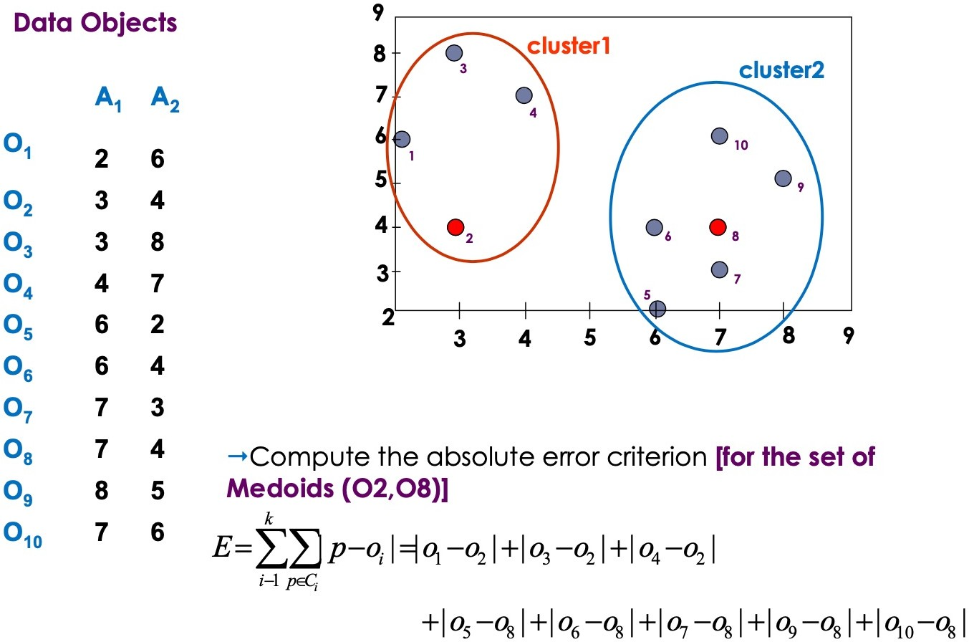
EXAMPLE

Slide 14
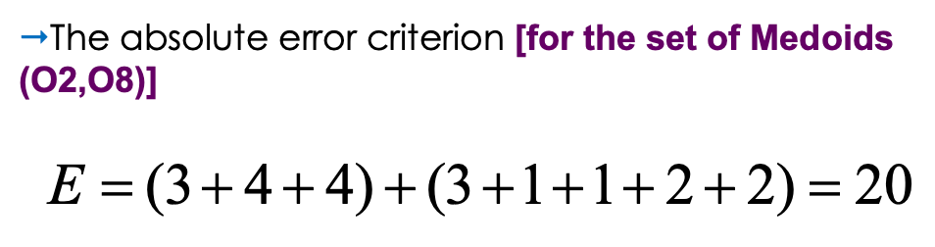
EXAMPLE

Slide 15
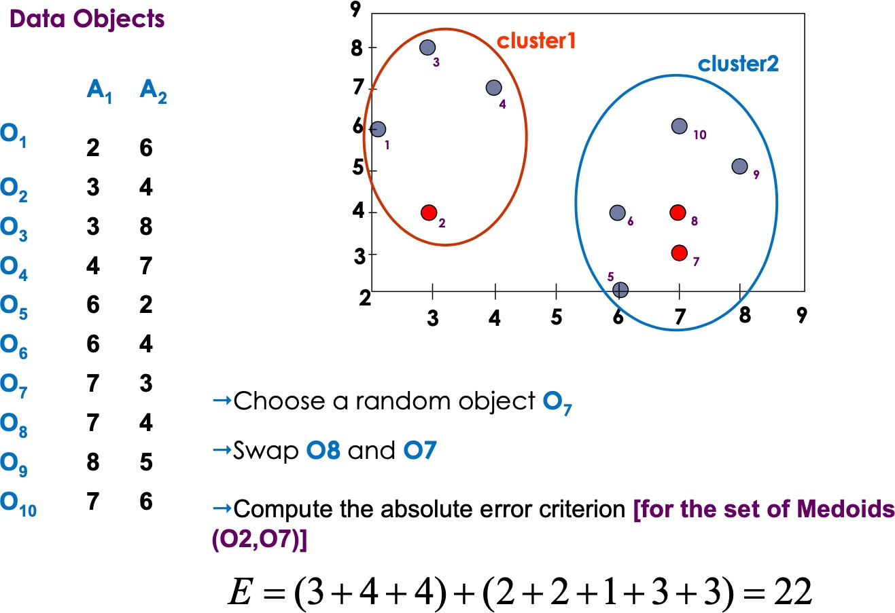

Slide 16
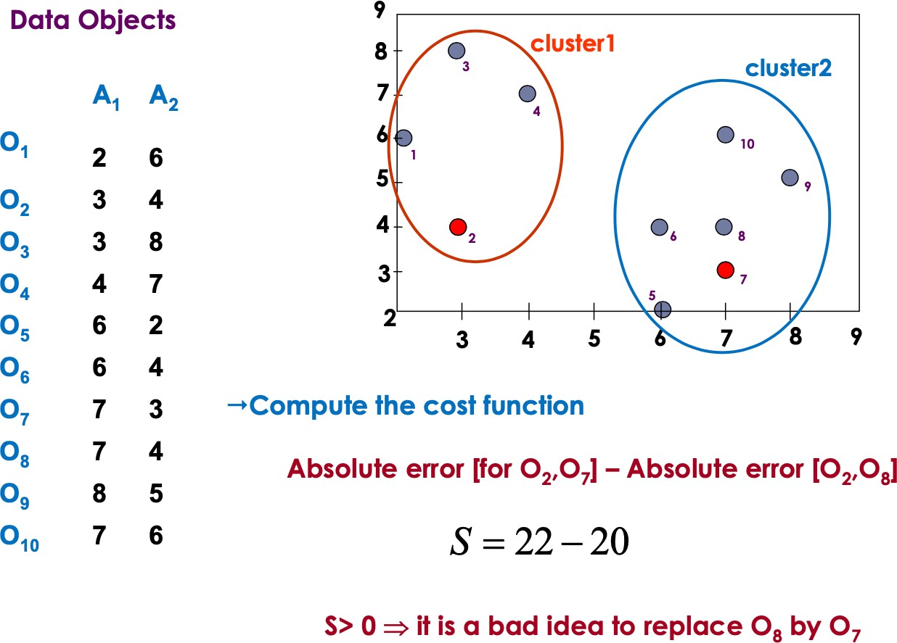

Slide 17
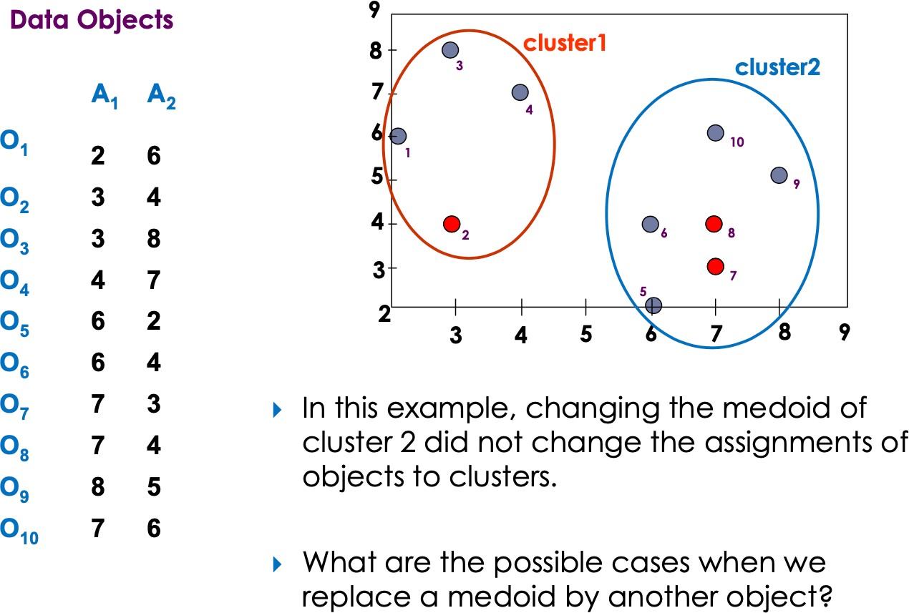

Slide 18
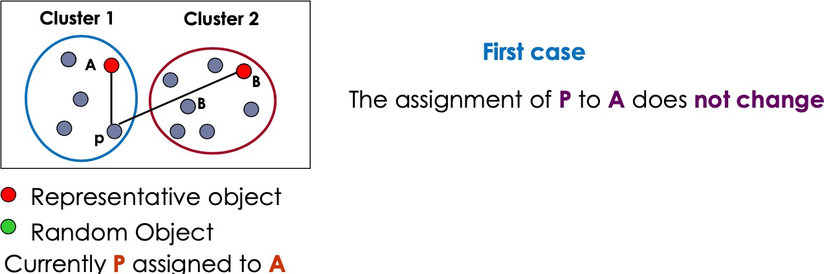
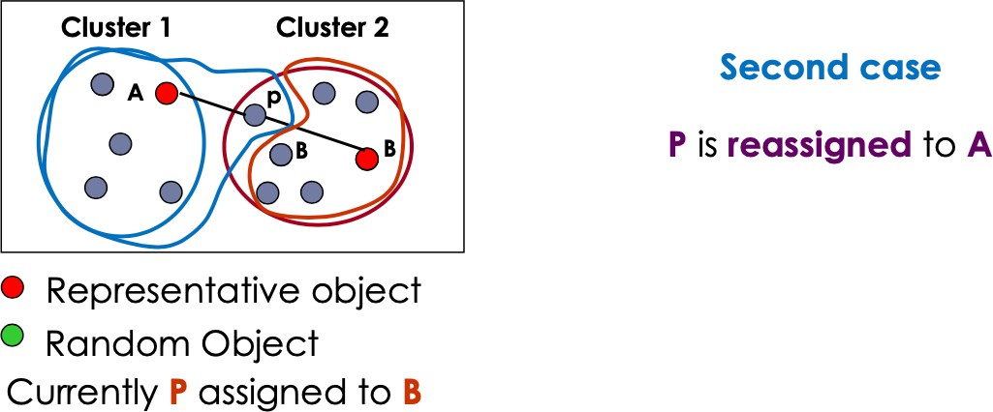

Slide 19
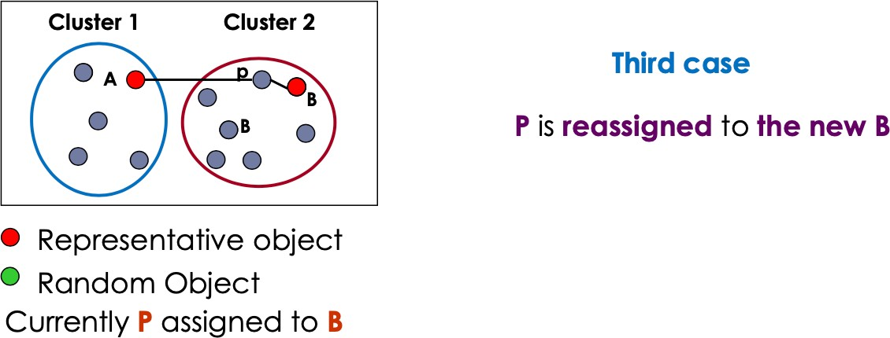
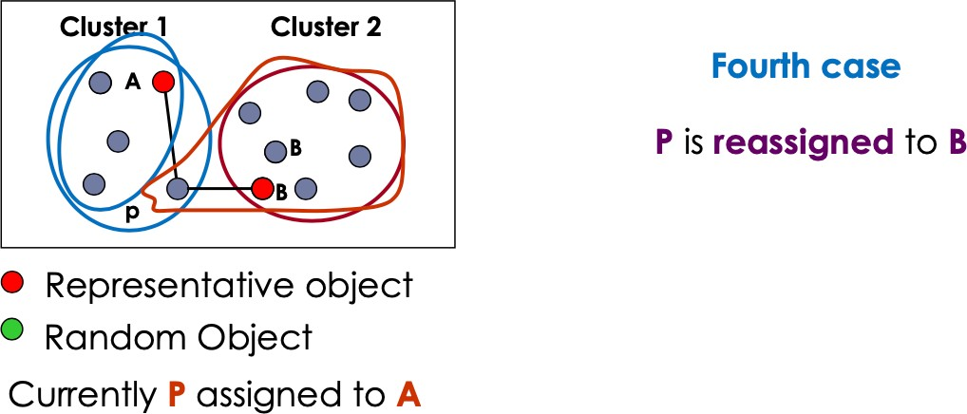

Slide 20
THE K-MEDOID CLUSTERING METHOD
K-Medoids Clustering: Find representative objects (medoids) in clusters
PAM (Partitioning Around Medoids, Kaufmann & Rousseeuw 1987)
Starts from an initial set of medoids and iteratively replaces one of the medoids by one of the non- medoids if it improves the total distance of the resulting clustering
PAM works effectively for small data sets, but does not scale well for large data sets (due to the computational complexity)
O(k(n-k)² ) for each iteration where n is # of data, k is # of clusters
Some variants of PAM are developed to improve efficiency of the original algorithm, e.g., CLARA, CLARAN.
CLARA (Clustering LARge Applications)
CLARAN (Clustering LARge Applications based on RANdomized search)

Slide 21
K-MEDOID
Advantages:
It is simple to understand and easy to implement.
K-Medoid Algorithm is fast and converges in a fixed number of steps.
PAM is less sensitive to outliers than other partitioning algorithms.
Disadvantages:
The main disadvantage of K-Medoid algorithms is that it is not suitable for clustering non- spherical (arbitrary shaped) groups of objects.This is because it relies on minimizing the distances between the non-medoid objects and the medoid (the cluster centre) – briefly, it uses compactness as clustering criteria instead of connectivity.
It may obtain different results for different runs on the same dataset because the first k medoids are chosen randomly.

Slide 22
READING MATERIAL
Chapter 9:Tan, Steinbach & Kumar
Chapter 10: Han, Kamber & Pei
Some articles on K-medoid
https://www.kdnuggets.com/2020/12/algorithms-explained-k-means-k-medoids- clustering.html
https://www.datanovia.com/en/lessons/k-medoids-in-r-algorithm-and-practical- examples/

